Slide 1
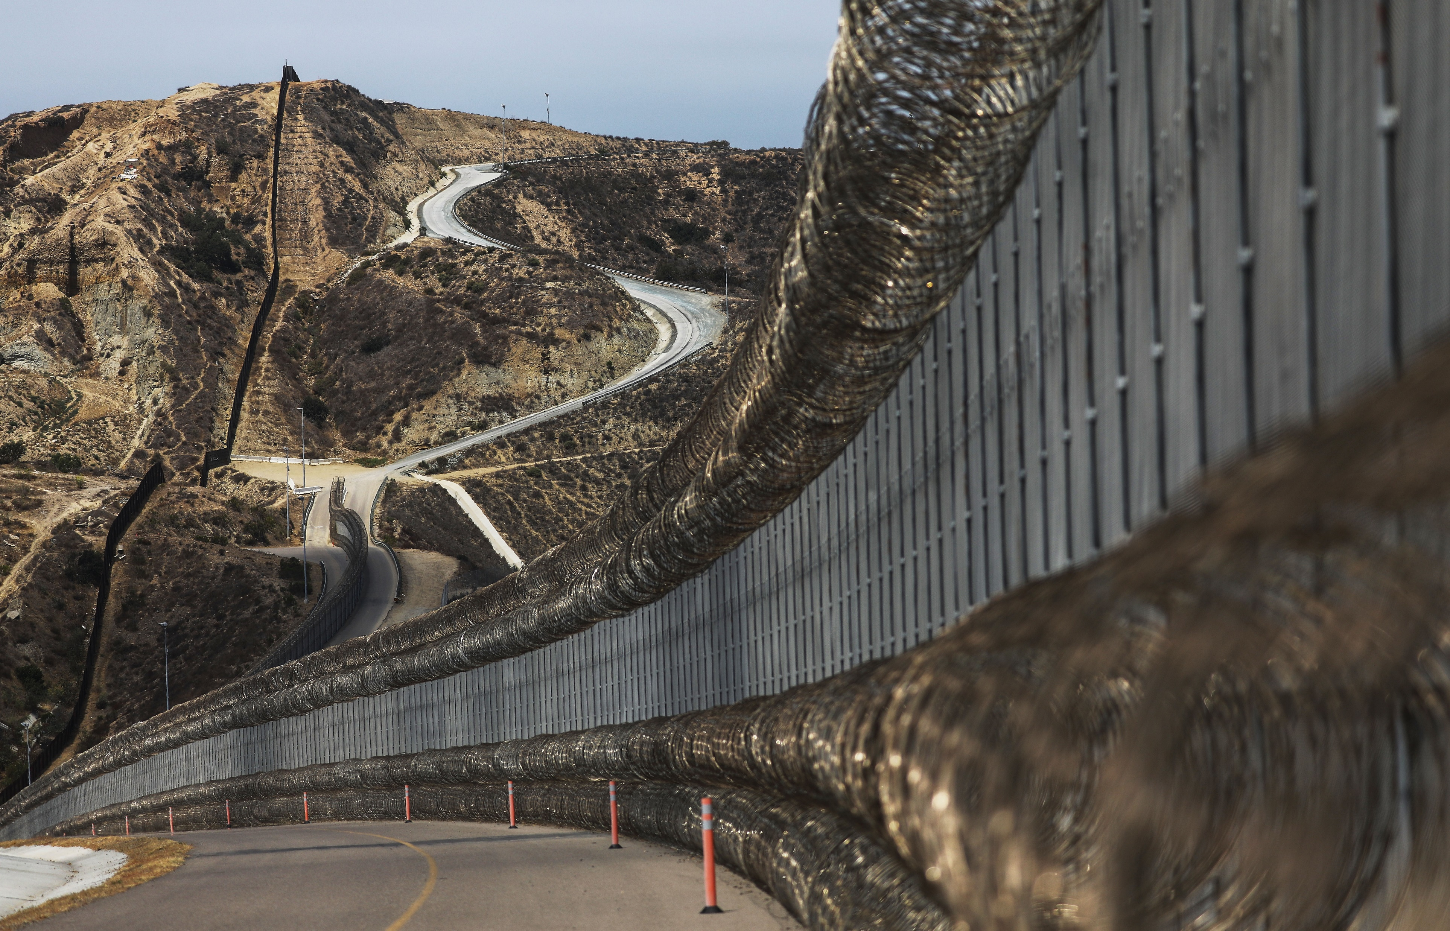
IMMIGRATION at Our Borders
Sources:
Bureau of Transportation Statistics (March 2013 thru March 2023)
U.S. Customs and Border Protection (2020-March 2023)
Migration at our U.S. Borders
Rosana Infante

Slide 2
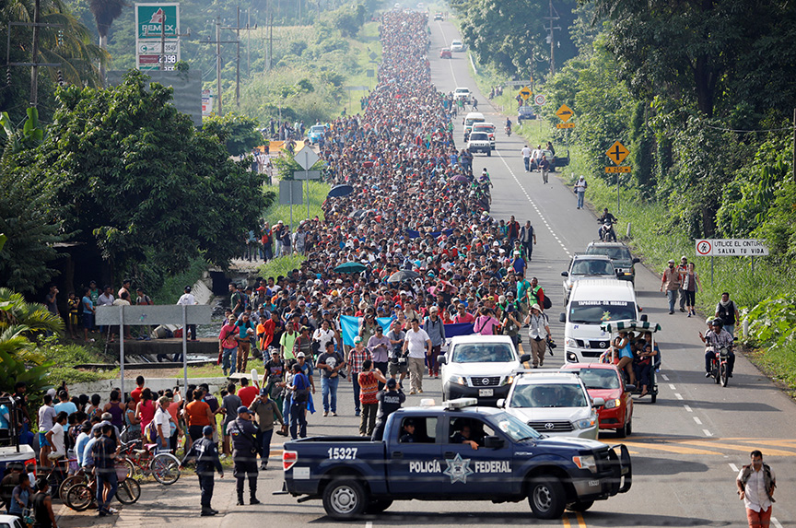
As officials brace for the expected migrant influx after May 11th:
At the state level, El Paso and Brownsville in Texas, NYC and Rockland County have declared state of emergency
The Department of Homeland Security plans to put more law enforcement officials on the southern border, increase capacity to process new arrivals, and implement more COVID-19 vaccination efforts.

Slide 3
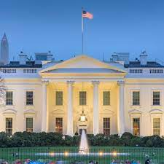
CBP One, app rolled out in January requires adult asylum seekers to book a meeting with U.S. officials or first claim asylum in another country before reaching the US border
The White House will be setting up brick-and-mortar immigration processing centers in Latin America starting in Colombia & Guatemala to screen migrants & determine whether they qualify for entry to the U.S.
Today 1,500 troops will be deployed for 90 days to fill critical capability gaps

Slide 4
How dire is the migrant situation at our US-Mexico border?
How many migrants does the U.S. Customs Border Patrol encounter at the Mexico border?
What are the demographics and nationalities most encountered?
What do these encounters result in?
How have the encounters changed over time?
Who is most affected by these encounters?

Slide 5

Dataset:
U.S. Customs and Border Protection
Southwest Land Border Encounters (2019-2022)
Tools:
Excel
Python
Tableau

Slide 6
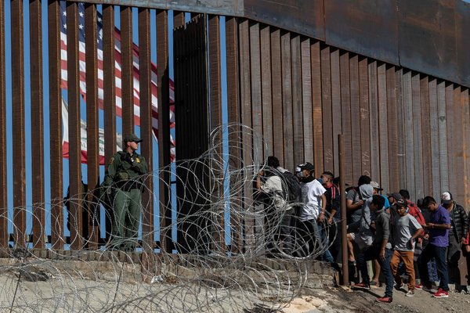
Background
Encounters - a metric where Border Patrol tracks migration patterns at the southwestern border resulting in expulsions, apprehensions, or inadmissibles
Inadmissibles - individuals seeking humanitarian protection under our laws or those who withdraw an application for admission and return to their country of origin after a short time frame.
Apprehensions – temporary detainment of a person not lawfully in the U.S. which may or may not result in an arrest

Slide 7
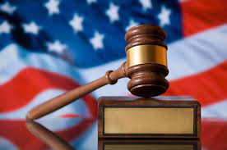
Title 8 a U.S. code that deals with immigration law, gives Border Patrol agents the ability to process and remove migrants who don’t have a legal basis to be in the US. They can be detained temporarily. Apprehensions and inadmissibles fall under this code.
Title 42 (part of pandemic restrictions in effect from March 2020-May 2023) border policy that allows officials to immediately turn away migrants on public health grounds returning them to their home country or most recent transit country. However, it even blocks asylum seekers from entering the U.S.

Slide 8
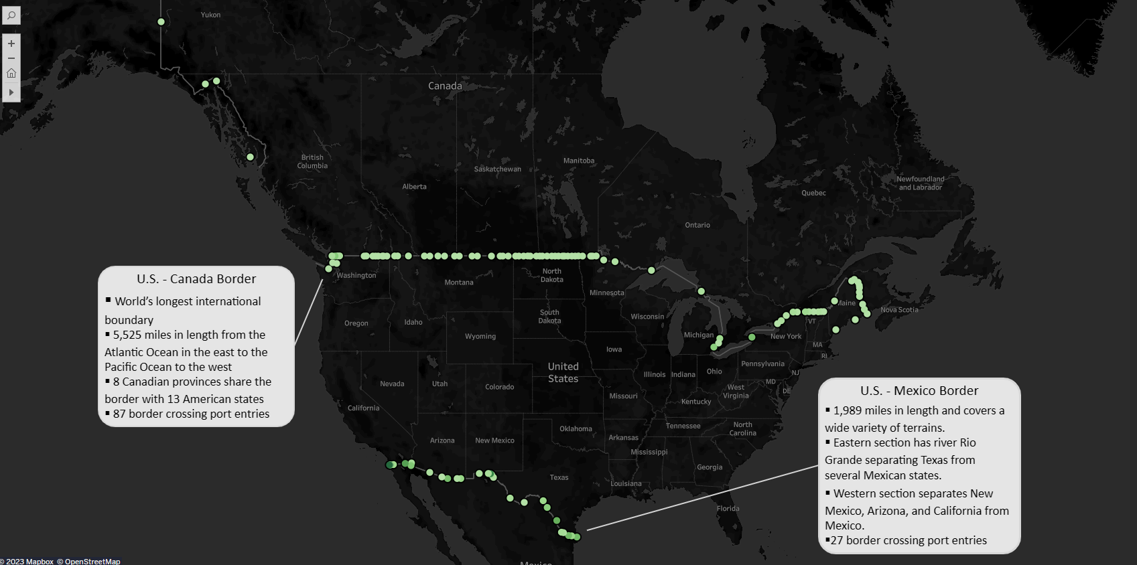

Slide 9
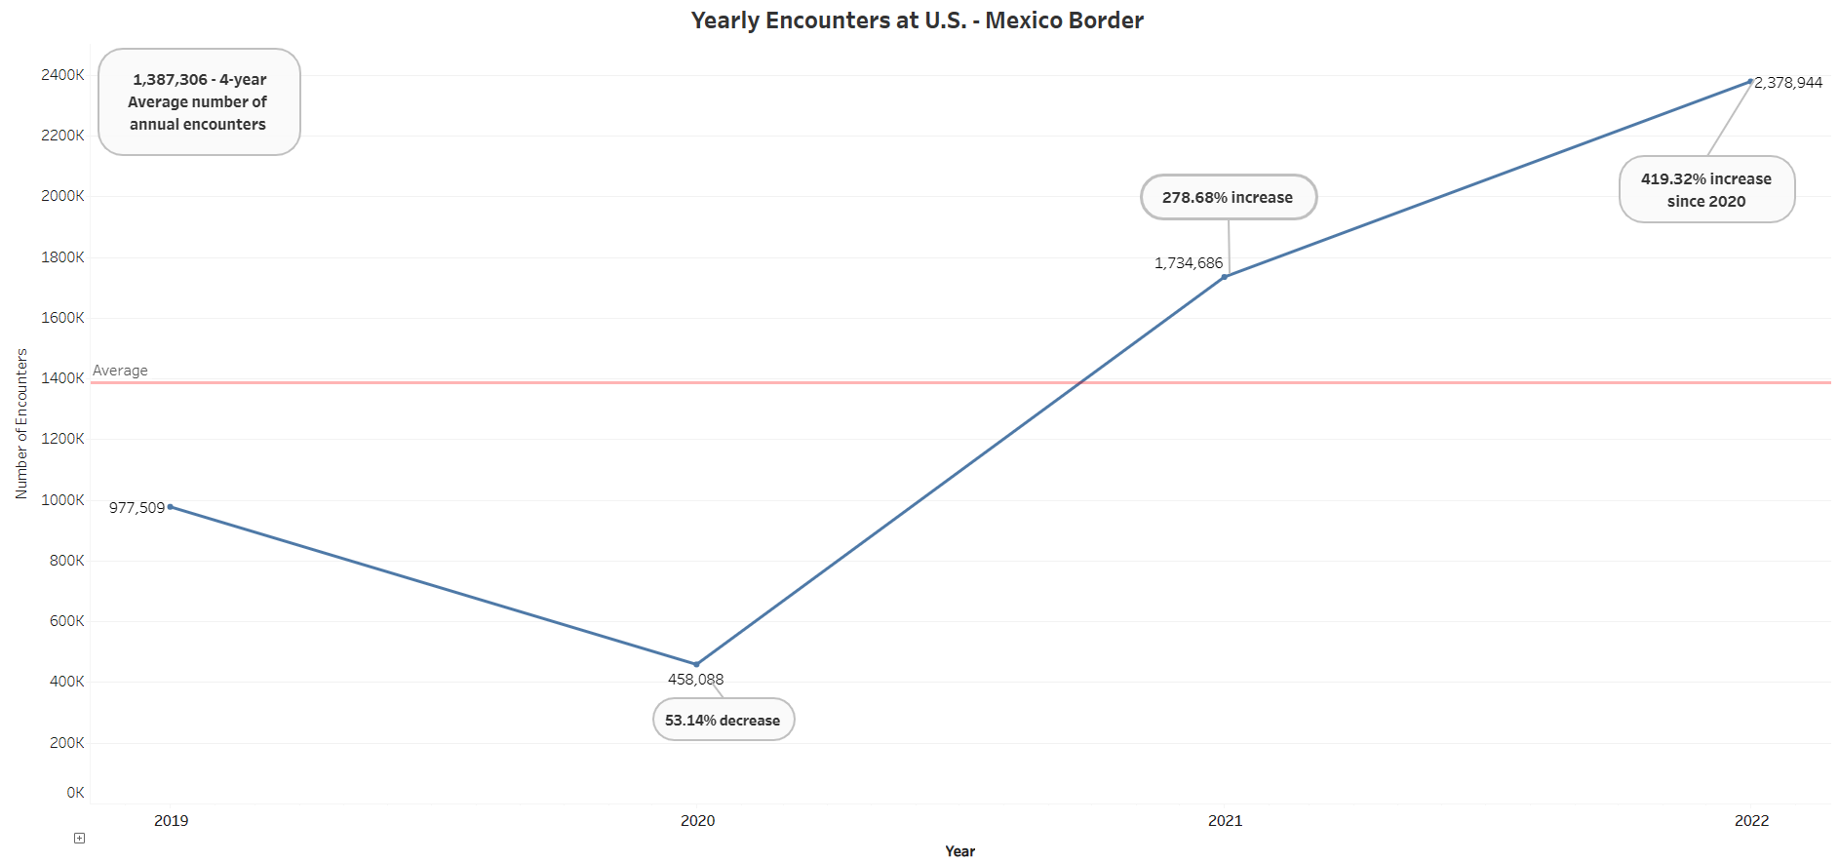

Slide 10
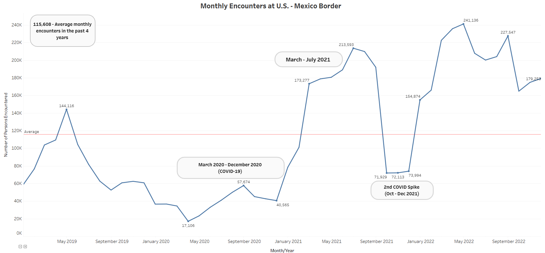

Slide 11
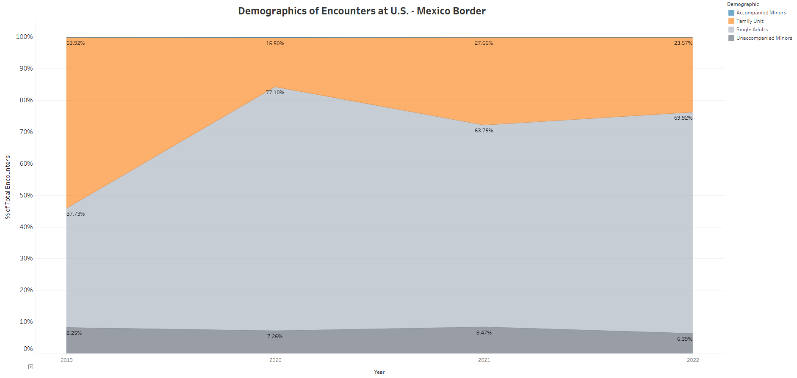

Slide 12
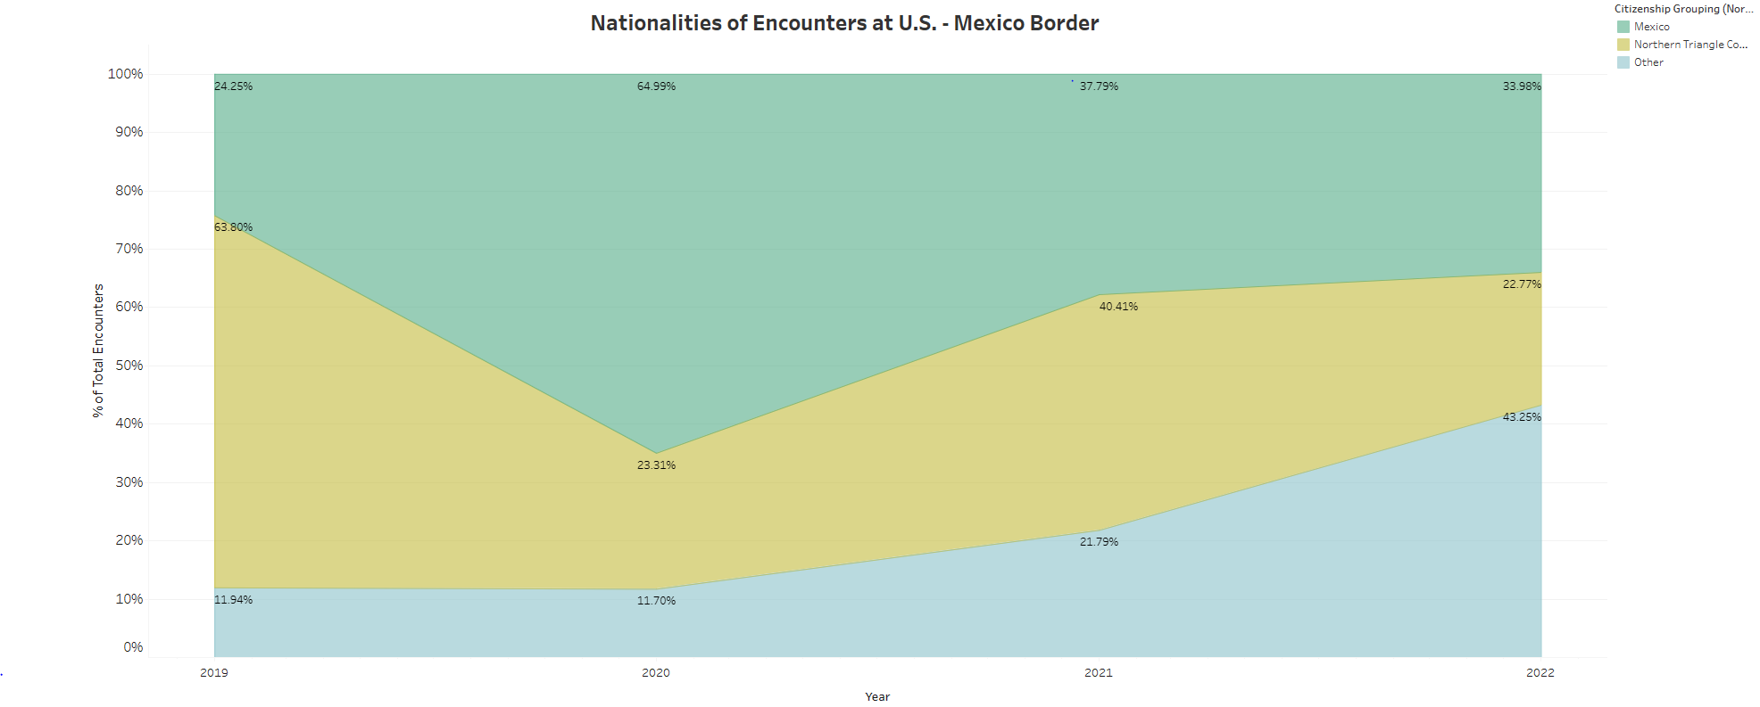

Slide 13
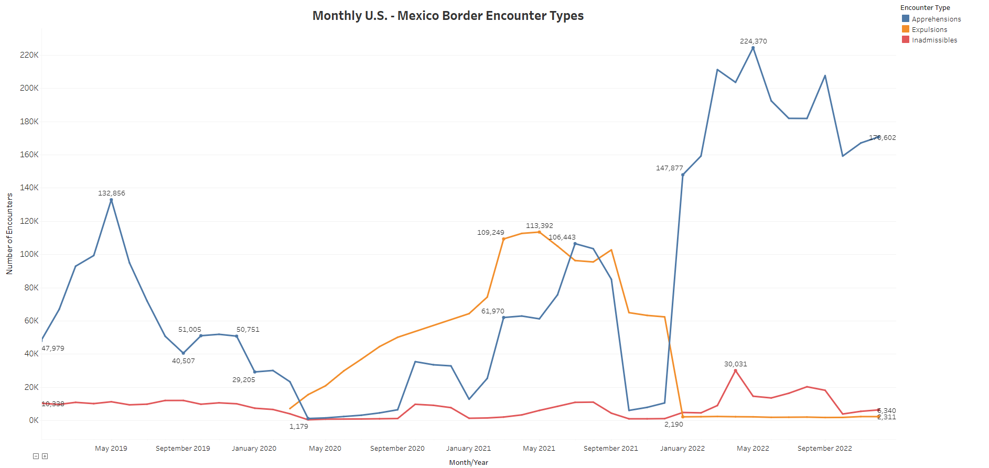

Slide 14
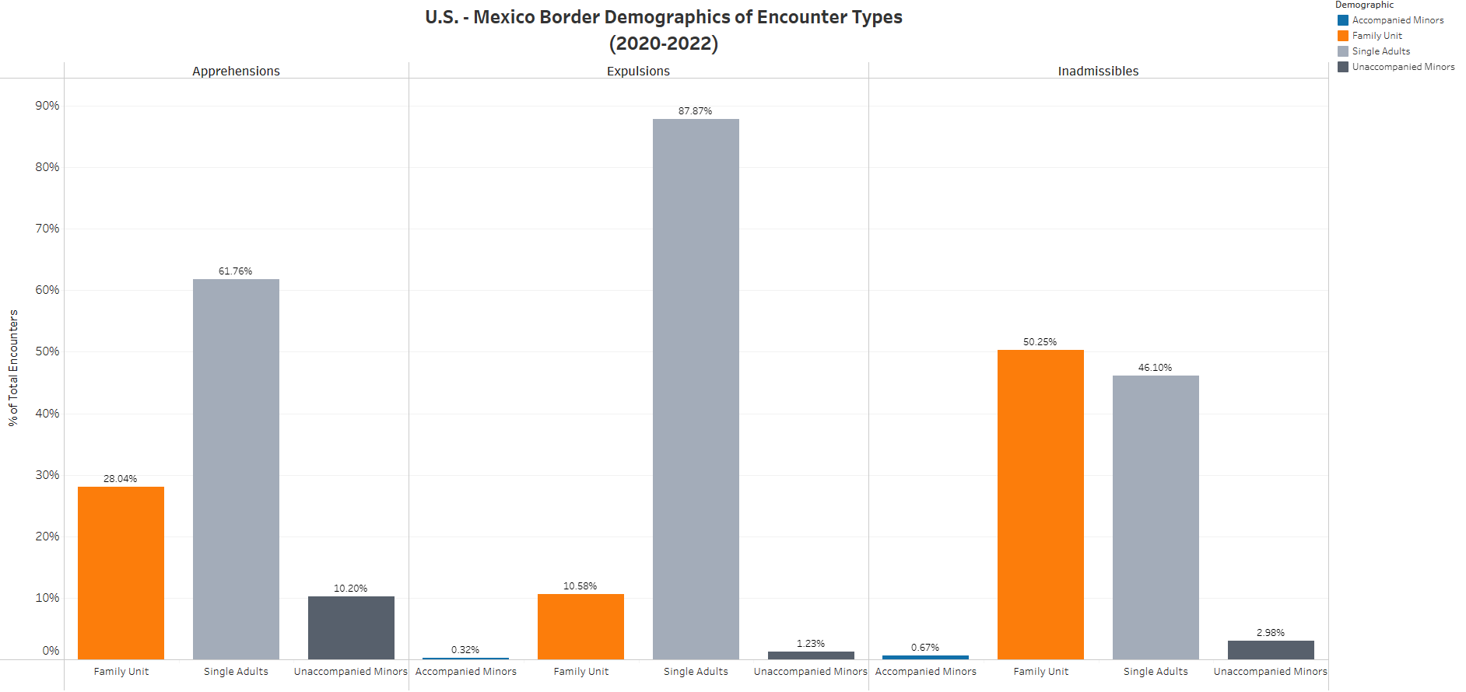

Slide 15
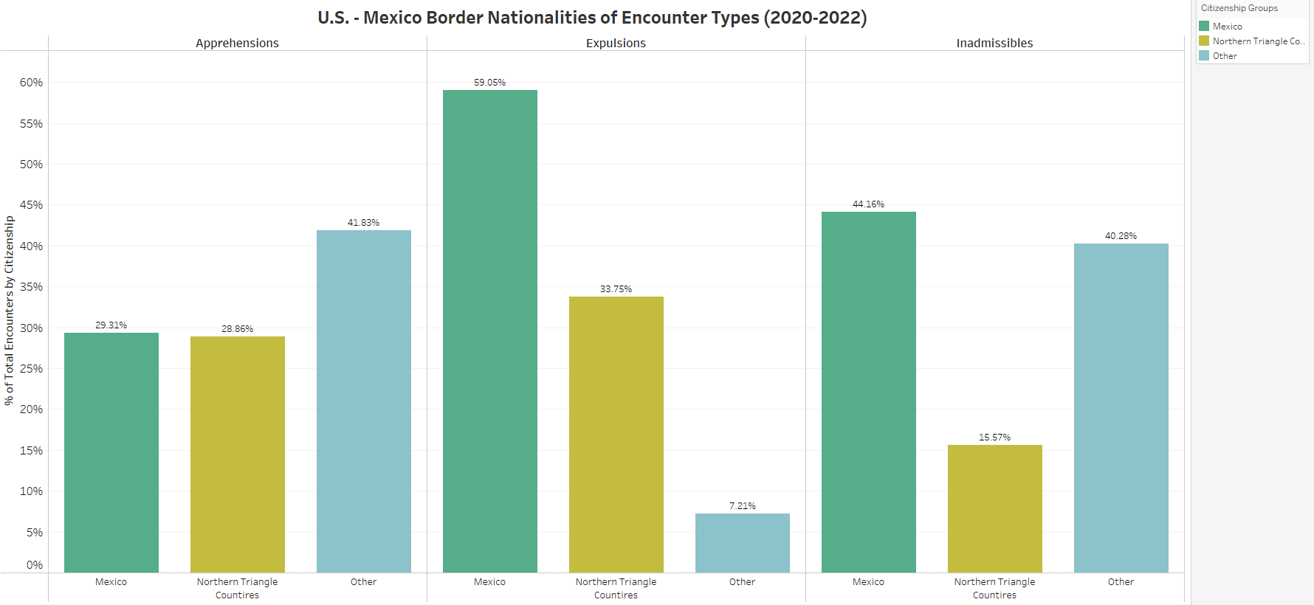

Slide 16
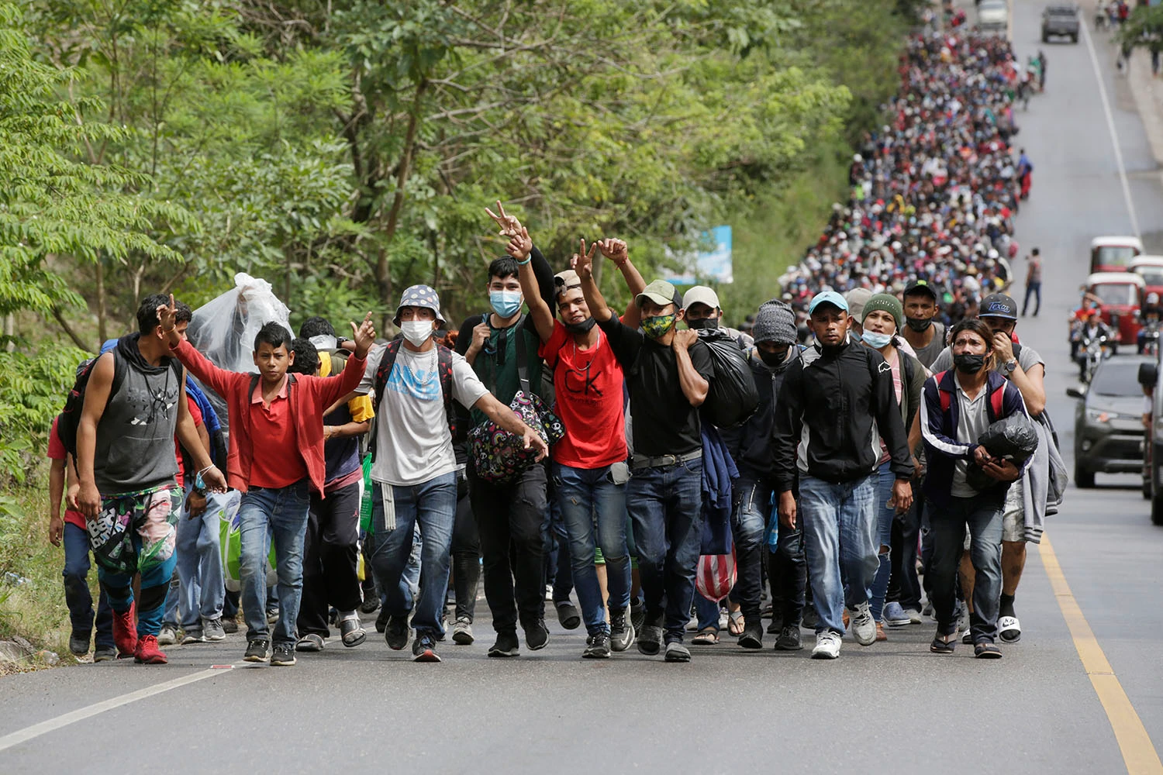
Conclusion
Migrants want to come to the U.S.A. looking for a better way of life due to economics, violence, and political problems in their countries. These driving forces have not changed, and many have gotten worse since 2020.
Data shows that:
Migrant encounters increased at a rapid rate of 419% since 2020
Single adults accounted for 63% of encounters
Citizens of Mexico accounted for 36% of encounters, and citizens of the Northern Triangle (Guatemala, Honduras, El Salvador) accounted for 35.56%
Border Patrol retained discretion over how to process migrants, but from April 2020 – December 2021, 61% resulted in expulsions under Title 42
Encounters with single adults mostly resulted in expulsion or apprehension
Encounters with citizens from the Northern Triangle countries and Mexico mostly resulted in expulsions
Notes:
And have averaged 1,387,306
Lowest number of monthly encounters were due to COVID from March-December 2020 and the COVID spike in October-December 2021
Monthly average encounters 115,806
March-Oct 2021 and Fiscal Year 2022 had monthly encounters well above the average
Title 8 is the only immigration code used by CBP for apprehensions and inadmissible
Title 42 is a health order invoked from March 2020 thru May 2023 which resulted in many expulsions including asylum seekers. It was the most encounter result from April 2020 thru June 2021 and again September thru Dec 2021 due to spike of encounters in July & August 2021. Plateaued all of 2022, 69% decrease since March 2020.

Slide 17
NEXT STEPS
Federal government financial aid for the states that are taking the financial brunt of providing shelter, food, and medical aid to asylum-seeking migrants
New proactive immigration law that addresses the migrant influx at our U.S. Borders swiftly
Asylum-seeking requests via CBP One should be required for all, not only adults

Slide 18
Sources
Dataset
Southwest Land Border Encounters | U.S. Customs and Border Protection (cbp.gov)
Articles
Title 42: 1,500 US troops to be deployed to southern border - BBC News
El Paso declares state of emergency before Title 42 ends (msn.com)
Title 42 explained: What to know about the Trump-era policy : NPR
Title 42 and immigration enforcement at U.S.-Mexico border: Key facts | Pew Research Center

Slide 19



DATA Analytics Team
linkedin.com/rosanainfante

